Slide 1
E-R Diagram
Conversion into tables
-

Slide 2
Conversion of E-R into tables
Conversion of an E-R diagram into a relational model is required because E-R diagrams represent the conceptual level of the database design while the relational model represents the logical level.

Slide 3
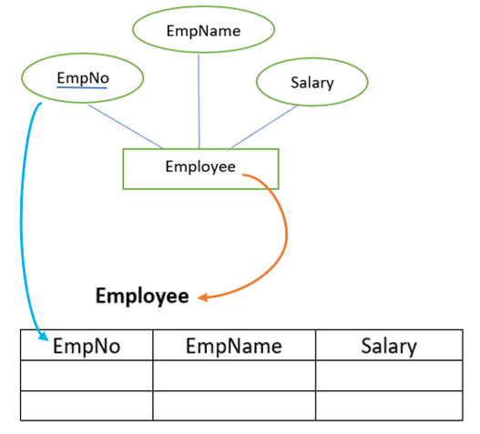
Scenario-1
Consider the following E-R diagram in the figure below. The E-R diagram consists of Employee as an entity set and EmpNo, EmpName, and Salary as its attributes.

Slide 4
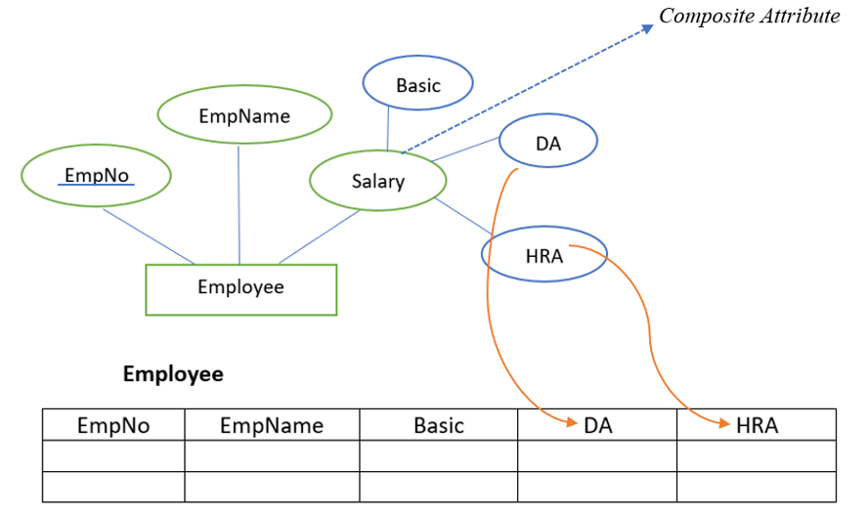
Scenario-2
For example in the figure given below, Salary is the composite attribute, and Basic, DA, and HRA are its compositions.
While converting an E-R diagram consisting of a composite attribute we do not include the composite attribute in the relational model. The compositions of the composite attribute will become the attributes in the relational model.

Slide 5

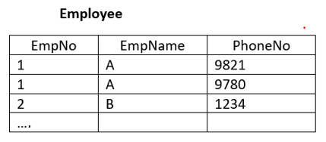
Scneario-3
If an entity contains a multivalued attribute, we split the attributes into two relations in the relational model. One with key attribute and all simple attributes and other with key attribute and all multivalued attributes. For example, in the figure given below, PhoneNo is the multivalued attribute.

Slide 6
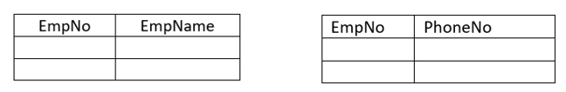
However, to avoid duplicate values in the table, we split the attributes into two different relations as shown in the figure below

Slide 7
How relationship are translated in a table
Likewise, we map the entity set into the relation in a relational model, we can also map a relationship set into a relation. The attribute of such a relation includes key attributes of the participating relations. The attributes will become a foreign key.
For example, in the figure given below, there are two entity sets Employee and Department. These entity sets are participating in a relationship works in. The relationship set is converted into relation with attributes EmpNo from Employee relation, D_id from Department relation and Since, the attribute of the relationship set itself.

Slide 8
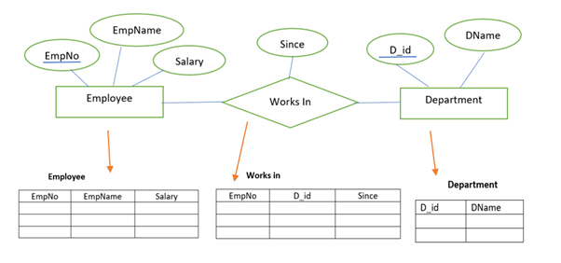
How relationship are translated in a table

Slide 9
Binary relationships with Cardinality Ratio
While determining the minimum number of tables required for binary relationships with given cardinality ratios, following thumb rules must be kept in mind-
For binary relationship with cardinality ration m : n , separate and individual tables will be drawn for each entity set and relationship.
For binary relationship with cardinality ratio either m : 1 or 1 : n , always remember “many side will consume the relationship” i.e. a combined table will be drawn for many side entity set and relationship set.
For binary relationship with cardinality ratio 1 : 1 , two tables will be required. You can combine the relationship set with any one of the entity sets.

Slide 10
Binary relationships with Cardinality Ratio and participation constraint
Because of the total participation constraint, foreign key acquires NOT NULL constraint i.e. now foreign key can not be null.
If there is no total participation then foreign key can be null.

Slide 11
Question
Consider the following tables:
Course (Course_id,Course_name)
Teacher (Teacher_id,Teacher_name)
Assigned_to (Teacher_id, Course_id)
a) How many tables will be created using the above scenario?
b) What will be the foreign key?

Slide 12
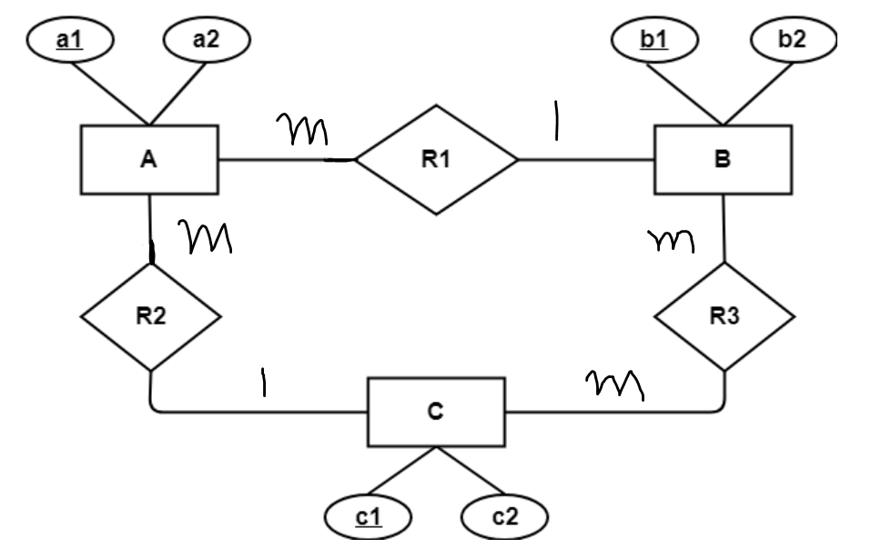
Question
Find the minimum number of tables for this scenario?

Slide 13
Let E1 and E2 be two entities in an E/R diagram with simple single-valued attributes. R1 and R2 are two relationships between E1 and E2, where R1 is one-to-many and R2 is many-to-many. R1 and R2 do not have any attributes of their own. What is the minimum number of tables required to represent this situation in the relational model? (A) 2 (B) 3 (C) 4 (D) 5

Slide 14
